Slide 1
Digital Fundamentals
CHAPTER 9 Counters

Slide 2
Chapter Outline
9-1 Finite State Machines
9-2 Asynchronous Counters
9-3 Synchronous Counters
9-4 Up/Down Synchronous Counters
9-5 Design of Synchronous Counters
9-6 Cascaded Counters
9-7 Counter Decoding
9-8 Counter Applications
9-9 Logic Symbols with Dependency Notation
9-10 Troubleshooting
9-11 Applied Logic

Slide 3
9–1 Finite State MachineS
A state machine is a sequential circuit having a limited (finite) number of states occuring in a prescribed order.
A counter is an example of a state machine; the number of states is called the modulus.
Two basic types of state machines are the Moore and the Mealy.
The Moore state machine is one where the outputs depend only on the internal present state.
The Mealy state machine is one where the outputs depend on both the internal present
state and on the inputs.

Slide 4
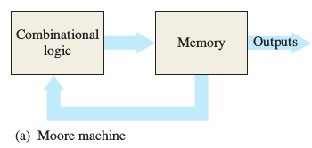
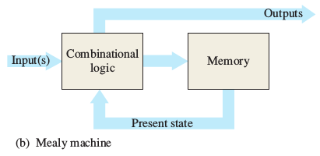
9–1 Finite State MachineS

Slide 5
Introduction
A counter – a group of flip-flops connected together to perform counting operations ( flip-flops are used to construct counters)
The number of flip-flops used and the way in which they are connected determine the number of states (modulus).
Two broad categories according to the way they are clocked:
Asynchronous counter
Synchronous counter
5
Notes:
5

Slide 6
Asynchronous Counter Operation
The term asynchronous refers to events that do not have a fixed time relationship with each other and, generally, do not occur at the same time.
An asynchronous counter is one in which the flip flops (FF) within the counter do not change states at exactly the same time because they do not have a common clock pulse.
6
Notes:
6

Slide 7
Asynchronous Counter Operation
Asynchronous binary counter
2-bit asynchronous binary counter
3-bit asynchronous binary counter
4-bit asynchronous binary counter
Asynchronous decade counter
7
Notes:
7

Slide 8
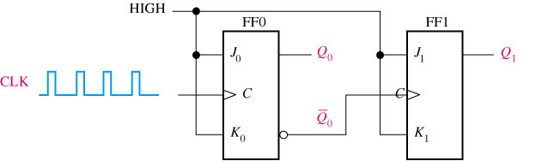
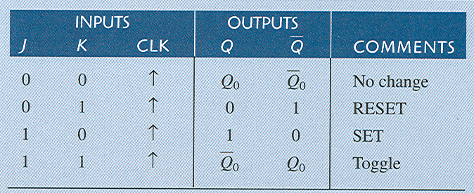
A 2-bit asynchronous binary counter
The clock (CLK) is applied to the clock input (C) of only the first flip flop which is always the least significant bit (LSB). The second flip flop is triggered by the output of the first flip flop.
Because of the inherent propagation delay time through a flip flop, a transition of the input clock pulse (CLK) and a transition of the output of FF0 can never occur at the exactly the same time. Therefore, the two flip flop are never simultaneously triggered, so the counter operation is asynchronous.
8
Notes:
8

Slide 9
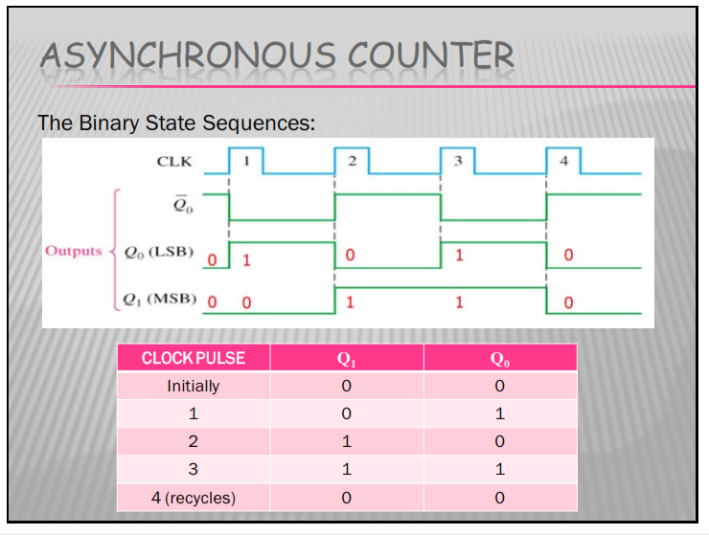
The Binary State Sequence for a 2-bit Binary Counter
9
Notes:
9

Slide 10
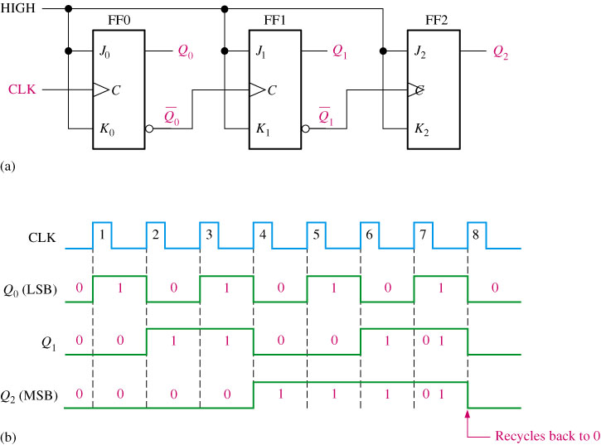
3-bit asynchronous binary counter and its timing diagram for one cycle
10
Notes:
10

Slide 11
The Binary State Sequence for a 3-bit Binary Counter
CLOCK PULSE | Q₂ | Q₁ | Q₀
Initially | 0 | 0 | 0
1 | 0 | 0 | 1
2 | 0 | 1 | 0
3 | 0 | 1 | 1
4 | 1 | 0 | 0
5 | 1 | 0 | 1
6 | 1 | 1 | 0
7 | 1 | 1 | 1
8 (recycles) | 0 | 0 | 0
11
Notes:
11

Slide 12
Asynchronous Decade Counters
The modulus of a counter is the number of unique states through which the counter will sequence.
The maximum possible number of states (max modulus) is 2^{n} . Where n is the number of flip-flops.
Counter can also be designed to have a number of states in their sequence that is less than the maximum of 2^{n}. The resulting sequence is called truncated sequence.
Counter with ten states are called decade counter.
To obtain a truncated sequence it is necessary to force the counter to recycle before going through all of its possible states.
12
Notes:
12

Slide 13
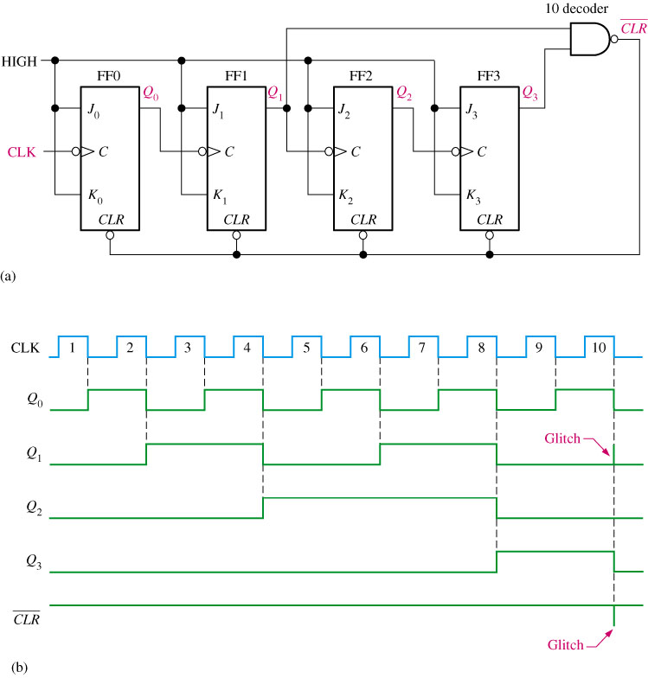
An Asynchronously Clocked Decade Counter with Asynchronous recycling
1010
13
Notes:
13

Slide 14
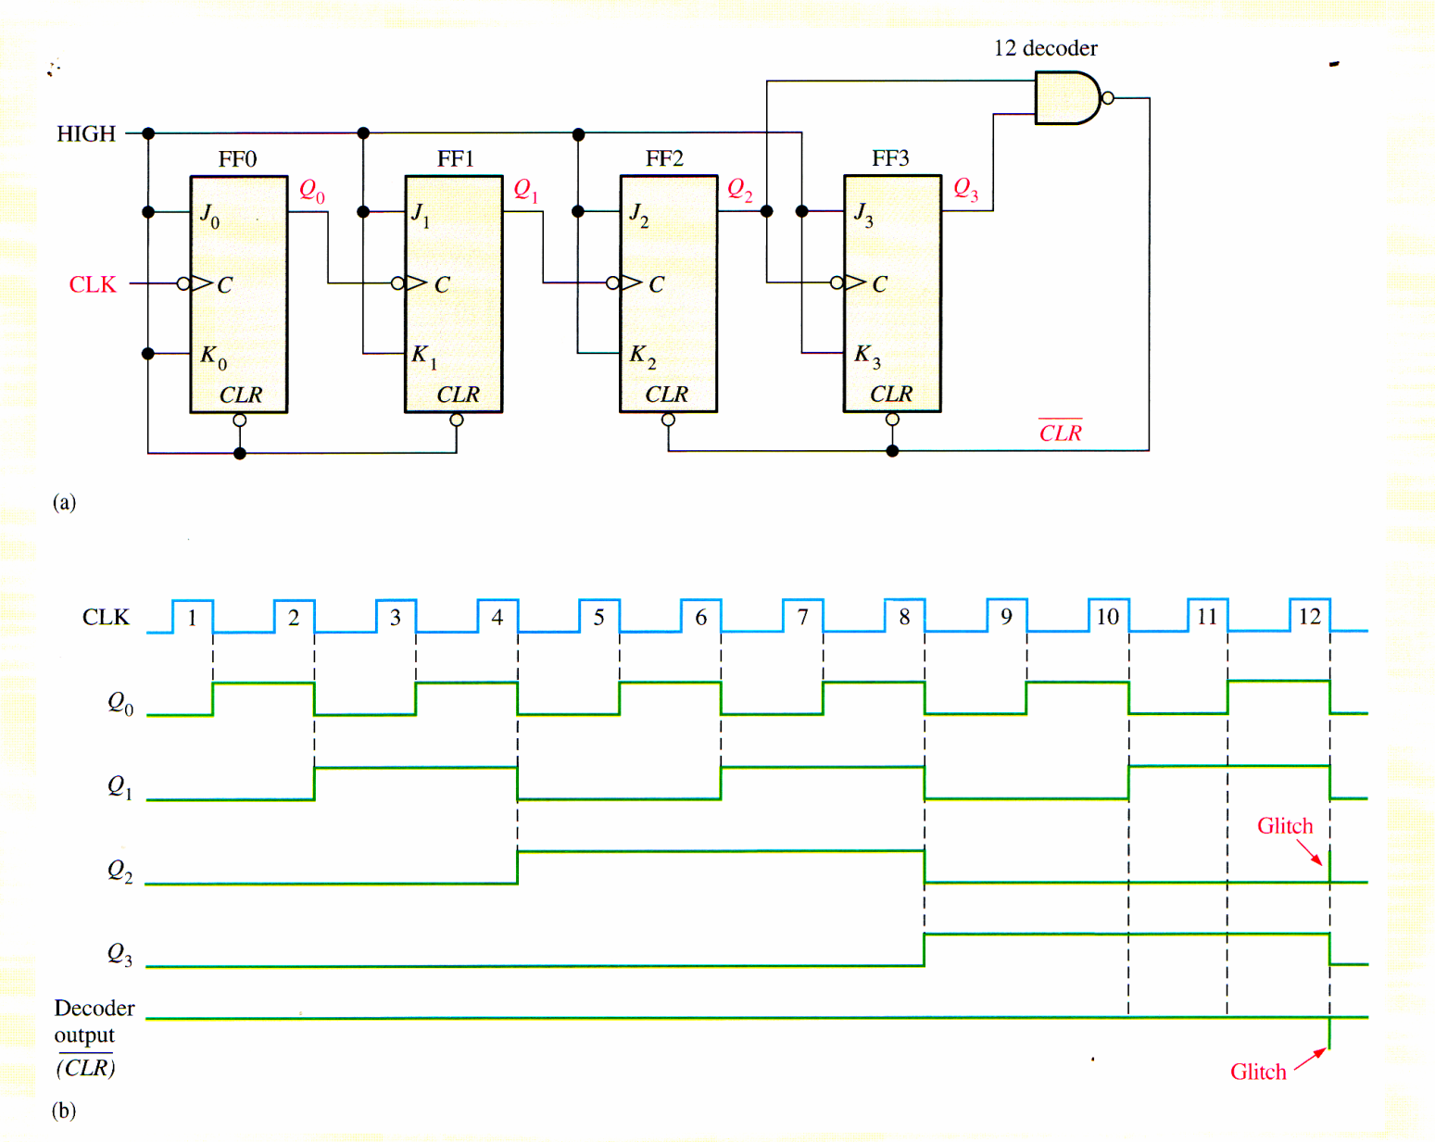
Example
Show how an asynchronous counter can be implemented having a modulus of twelve with a straight binary sequence from 0000 through 1011.
14
Notes:
14

Slide 15
Synchronous Counter Operation
Synchronous refers to events that have a fixed time relationship with each other.
A synchronous counter is one in which all the flip flops in the counter are clocked at the same time by a common clock pulse.
Synchronous binary counters
2-bit counter
3-bit counter
4-bit counter
Synchronous BCD decade counter
15
Notes:
15

Slide 16
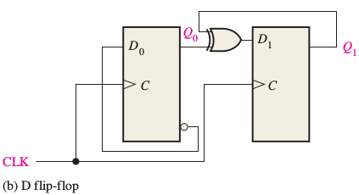
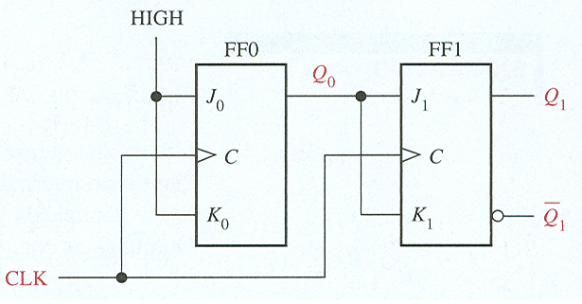
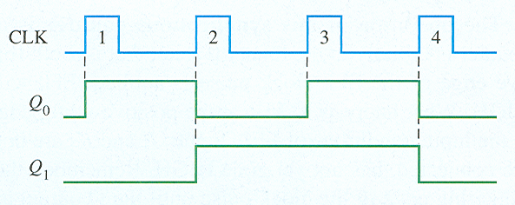
A 2 bit Synchronous Binary Counter
16
Notes:
16

Slide 17
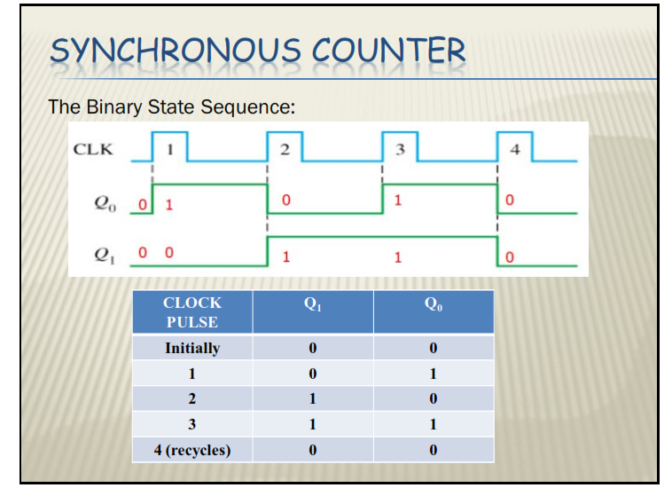
17
Notes:
17

Slide 18
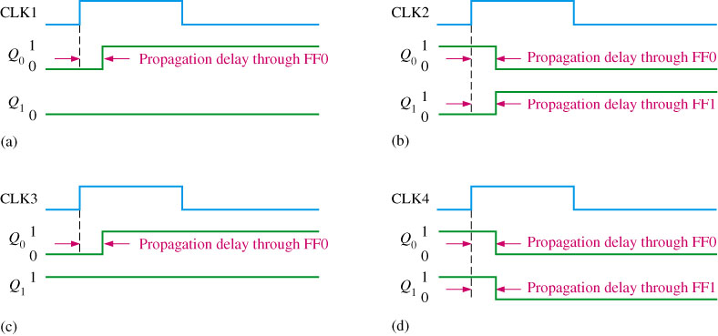
Timing details for the 2-bit synchronous counter operation (the propagation delays of both flip-flops are assumed to be equal)
18
Notes:
18

Slide 19
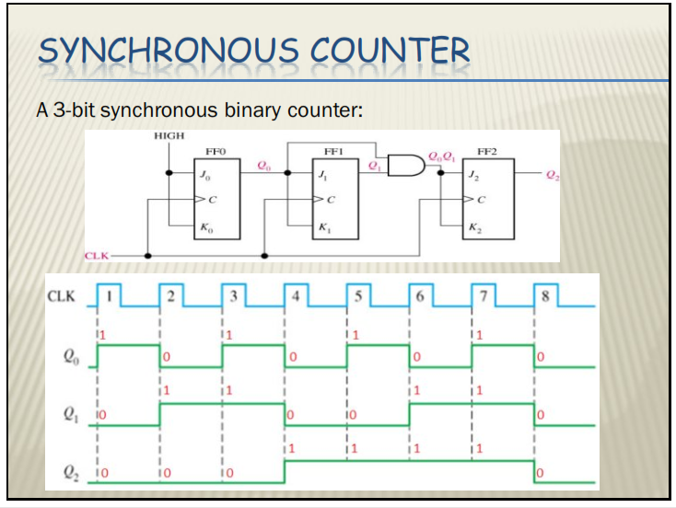
19
Notes:
19

Slide 20
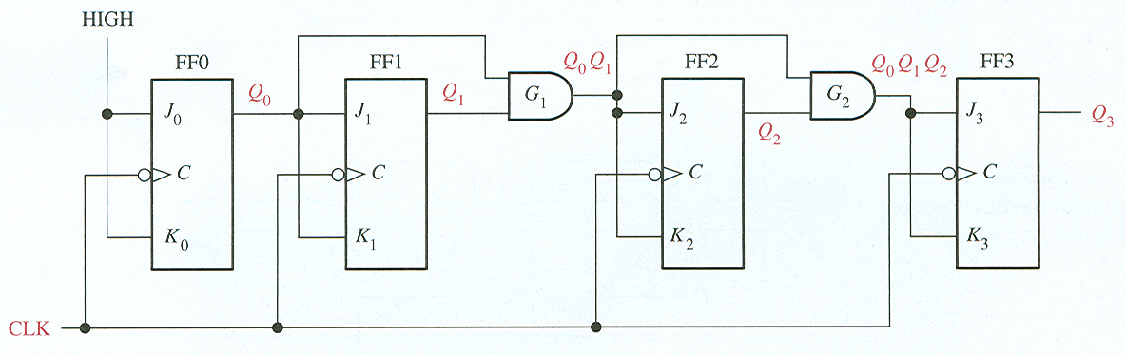
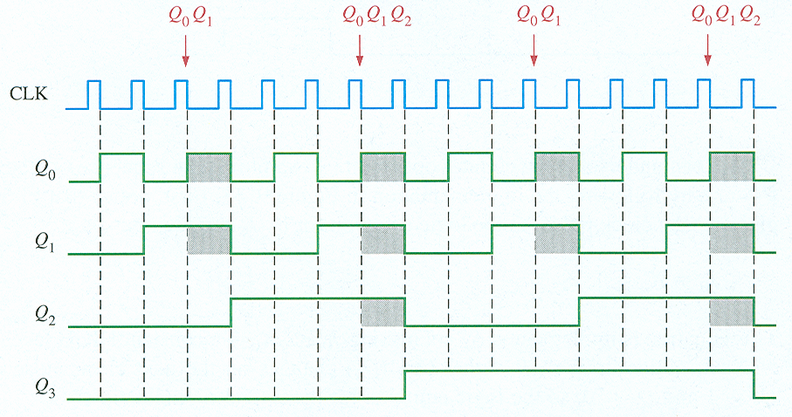
A 4 bit Synchronous Binary Counter
20
Points where the AND gate outputs are HIGH are indicated by the shaded areas.
Notes:
20

Slide 21
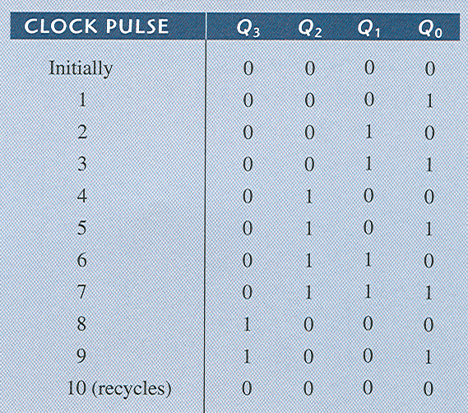
States of a 4 bit Synchronous Decade Counter
21
Q1 (Q 0 = 1 and Q 3 = 0), Q2 (Q 0 = 1 and Q 1 = 1),
Q3 (Q 0 = 1, Q 1 = 1, and Q 2 = 1 (state 7), or when Q0 = 1 and Q3 = 1)
Notes:
21

Slide 22
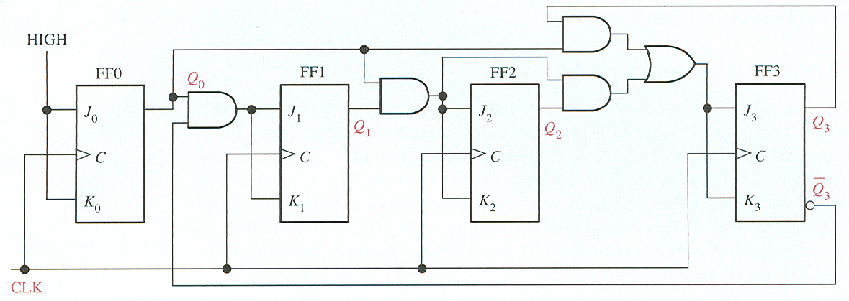
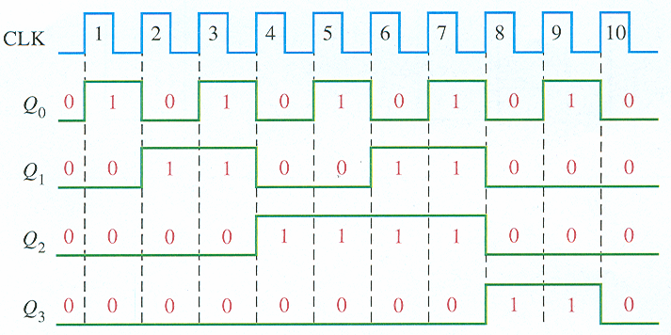
A 4 bit Synchronous Decade Counter
22
Notes:
22

Slide 23
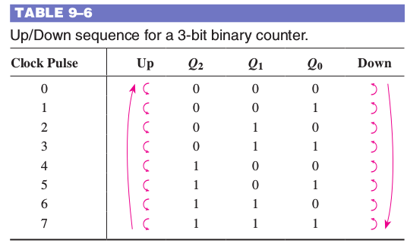
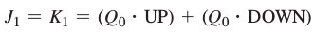
9–4 Up/Down Synchronous Counters
FF0 toggles on each clock pulse
J 0 = K 0 = 1
For the up sequence, Q1 changes state on the next clock pulse when Q 0 = 1. For the down sequence, Q 1 changes on the next clock pulse when Q 0 = 0.
23
Notes:
23

Slide 24
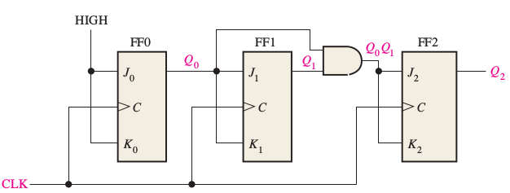
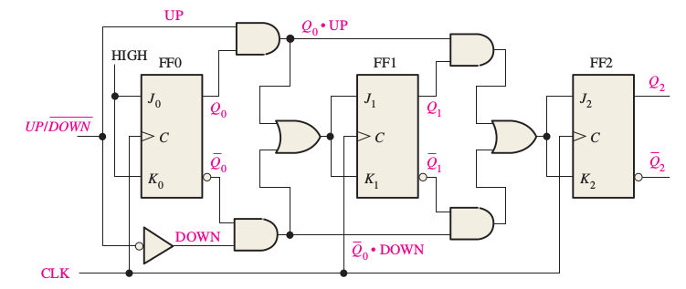
9–4 Up/Down Synchronous Counters
J 0 = K 0 = 1
24
Notes:
24

Slide 25
9–5 Design of Synchronous Counters
Steps to design a counter (state machine)
Step 1: State Diagram
Step 2: Next-State Table
Step 3: Flip-Flop Transition Table
Step 4: Karnaugh Maps
Step 5: Logic Expressions for Flip-Flop Inputs
Step 6: Counter Implementation
Notes:
25

Slide 26
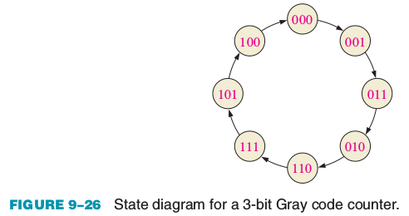
9–5 Design of Synchronous Counters
Step 1: State Diagram
Notes:
26

Slide 27
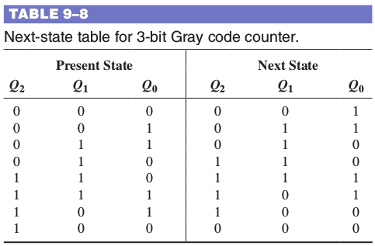
9–5 Design of Synchronous Counters
Step 2: Next State Table
Notes:
27

Slide 28
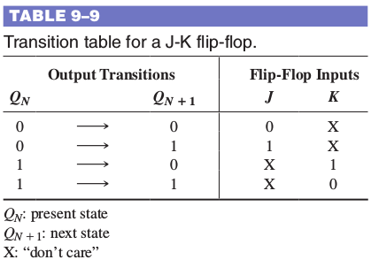
9–5 Design of Synchronous Counters
Step 3: Transition Table
Notes:
28

Slide 29
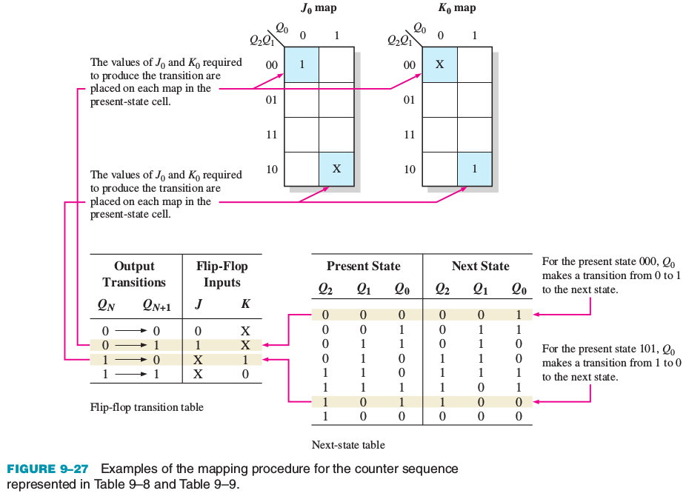
9–5 Design of Synchronous Counters
Step 4: Karnaugh Maps
Notes:
29

Slide 30
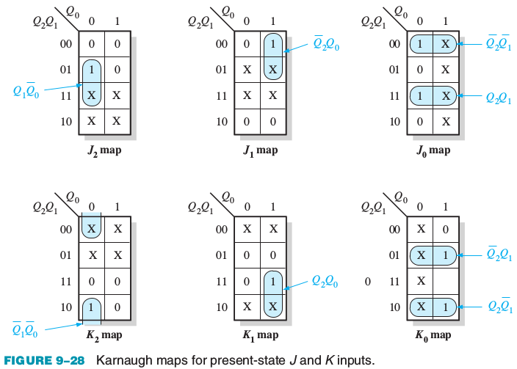
9–5 Design of Synchronous Counters
Step 4: Karnaugh Maps
Notes:
30

Slide 31
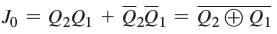
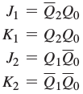
9–5 Design of Synchronous Counters
Step 5: Logic Expressions for Flip-Flop Inputs
Notes:
31

Slide 32
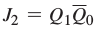
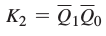
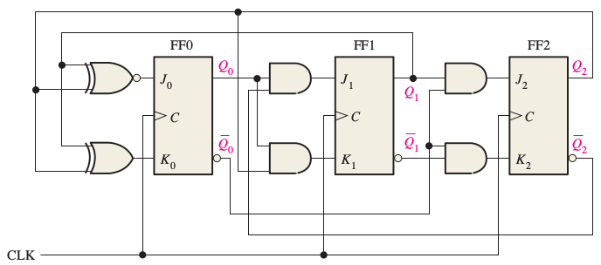
9–5 Design of Synchronous Counters
Step 6: Counter Implementation
Notes:
32

Slide 33

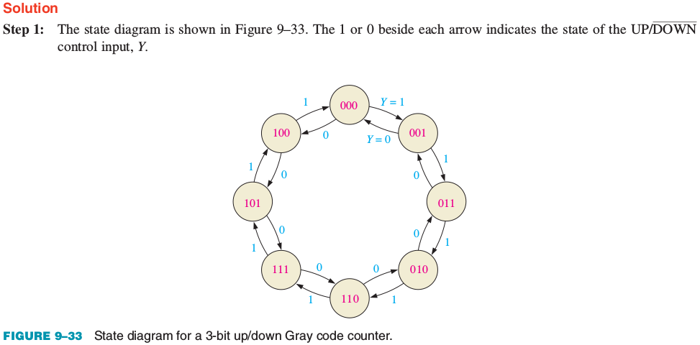
Example 9–5 Design of Synchronous Counters
Notes:
33

Slide 34
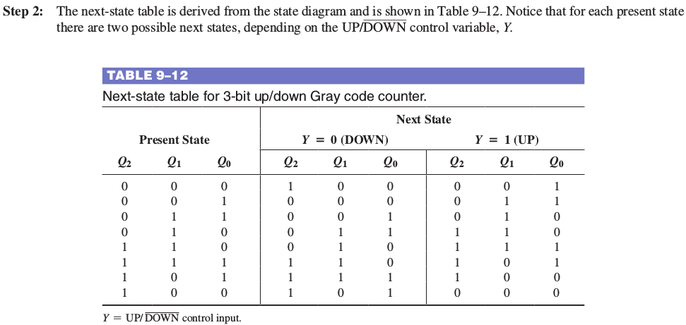
Example 9–5 Design of Synchronous Counters
Notes:
34

Slide 35
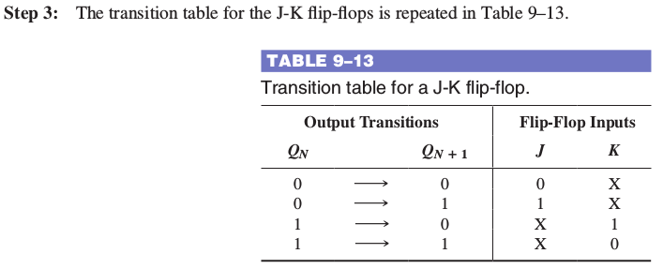
Example 9–5 Design of Synchronous Counters
Notes:
35

Slide 36
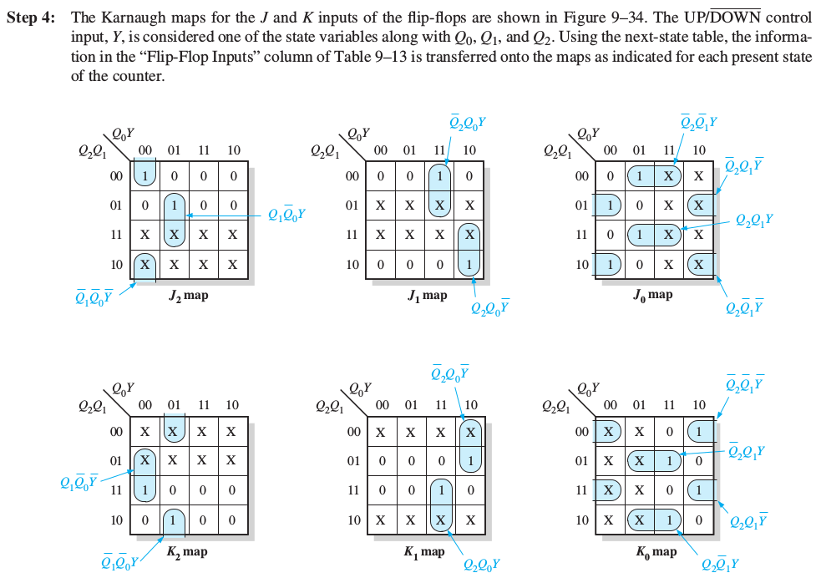
Example 9–5 Design of Synchronous Counters
Notes:
36

Slide 37
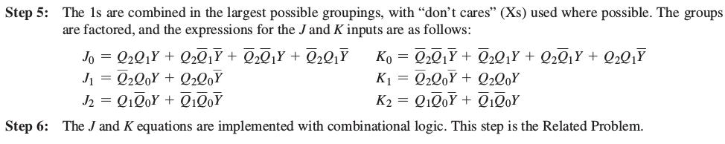
Example 9–5 Design of Synchronous Counters
Notes:
37

